Slide 1
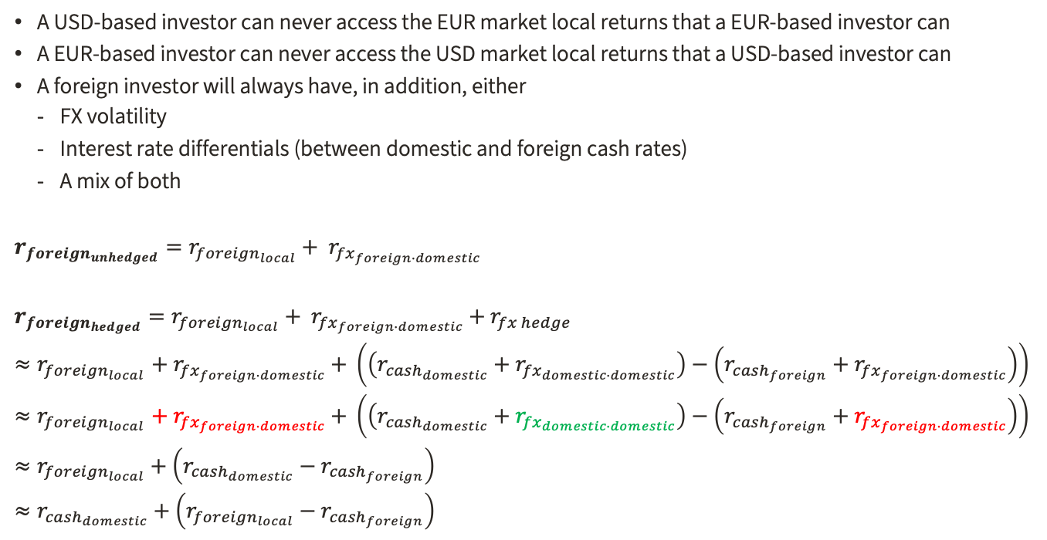
Foreign Returns from a Domestic Perspective
Local currency returns across markets are not comparable. Your home base is important.
A USD-based investor can never access the EUR market local returns that a EUR-based investor can
A EUR-based investor can never access the USD market local returns that a USD-based investor can
A foreign investor will always have, in addition, either
FX volatility
Interest rate differentials (between domestic and foreign cash rates)
A mix of both
$$r_{{foreign}_{unhedged}}=r_{{foreign}_{local}}+ r_{{fx}_{foreign∙domestic}}$$
$r_{{foreign}_{hedged}}=r_{{foreign}_{local}}+ r_{{fx}_{foreign∙domestic}}$ $+ r_{fx hedge}$
${≈r}_{{foreign}_{local}}+ r_{{fx}_{foreign∙domestic}}$ $+ \left(\left(r_{{cash}_{domestic}}+r_{{fx}_{domestic∙domestic}}\right)−\left(r_{{cash}_{foreign}}+r_{{fx}_{foreign∙domestic}}\right)\right)$
${≈r}_{{foreign}_{local}}+ r_{{fx}_{foreign∙domestic}}$ $+ \left(\left(r_{{cash}_{domestic}}+r_{{fx}_{domestic∙domestic}}\right)−\left(r_{{cash}_{foreign}}+r_{{fx}_{foreign∙domestic}}\right)\right)$
$$≈r_{{foreign}_{local}}+\left(r_{{cash}_{domestic}}−r_{{cash}_{foreign}}\right)$$
$$≈r_{{cash}_{domestic}}+\left(r_{{foreign}_{local}}−r_{{cash}_{foreign}}\right)$$
unhedged return $≈$ local return of foreign asset + currency return
hedged return $≈$ domestic cash + excess return of foreign asset vs. foreign cash
*”cash” is implied cash rate from forwards, which includes bias. e.g. EURI1M, from Bloomberg

Slide 2
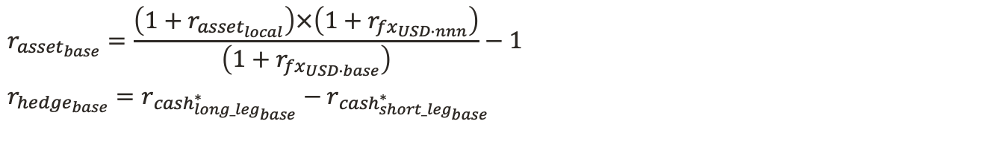
Base Currency Return Calculations
2 steps: find return in USD, then convert to base currency
$$r_{{asset}_{base}}=\frac{\left(1+r_{{asset}_{local}}\right)×\left(1+r_{{fx}_{USD∙nnn}}\right)}{\left(1+r_{{fx}_{USD∙base}}\right)}−1$$
$r_{{hedge}_{base}}=r_{{cash}_{{long_leg}_{base}}^{∗}}−$ $r_{{cash}_{{short_leg}_{base}}^{∗}}$
asset returns in local currency
fx returns in USD
asset returns in USD
base FX in USD
asset returns in base currency
x
=
/
=
*implied cash rate from forwards, e.g. EURI1M Index, etc. (from Bloomberg)

